Slide 1
FRC: A Primer
MVRT - FRC 115
September 26, 2016

Slide 2
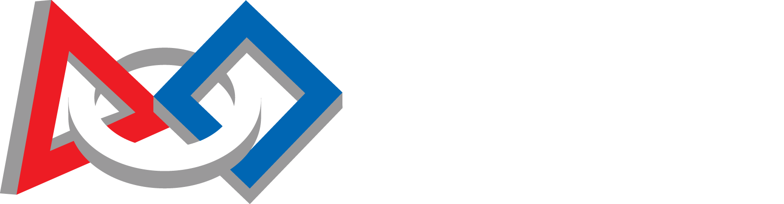
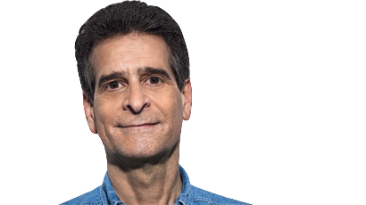
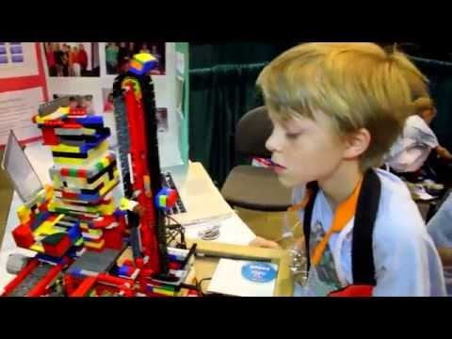
For Inspiration and Recognition of Science and Technology
2,200+
Events held worldwide
400,000 Students
In
2 Championships
Houston & St. Louis, starting 2017
4 Programs
For students K-12
$22,000,000+
Available in scholarships annually
40,000+
Attendees at St. Louis Championships, 2016
Dean Kamen, Founder
(Also invented the segway)

Slide 3
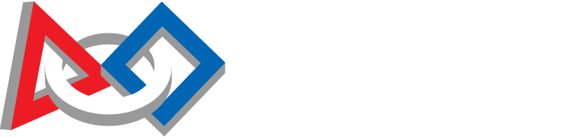
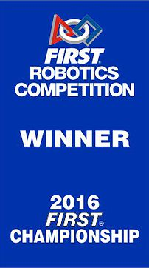
(The flagship program of FIRST)
4,000+
Teams worldwide
6 Weeks
To design, build, and program
120lbs
Robot weight limit
1 Goal:
We attend
2 Regionals
Every Year
27’x54’
Playing Field
50+ Teams
At every regional competition

Slide 4
Overall Schedule
January 7, 2017: Kickoff (Challenge Released)
February 21, 2017: Stop Build Day
March-April: Competitions (6 consecutive weekends)
April 19th: Houston Championships

Slide 5
Build Season
We have 6 weeks to: strategize, design, prototype, manufacture, program, and iterate on our robot. That’s jam-packed!
Kickoff:
Watch kickoff livestream/game animation
Read through rules
Analyze game, brainstorming/discussing potential strategies
Ultimately decide strategic priorities (the “what”)
Days 2,3:
Building off of the defined priorities, we decide/plan the “how”
Strategy -> Ideas -> Prototypes -> Iterations -> Final Robot

Slide 6
The Game
Each Match Consists of:
2 Alliances
3 Teams Per alliance
15 second autonomous (pre-programmed) period
2:15 teleoperated (driver-controlled) period
Game objects/Field elements (vary by game)
Various scoring methods (vary by game)
Past Games
2016 Competition: FIRST Stronghold
2015: Recycle Rush
2014: Aerial Assist
2013: Ultimate Ascent
….
Official Resources
Game Animation: General overview of the game
Game Manual: ~50 page document with rules, scoring, field layout/dimensions, etc
Game Updates/Q&A: Rule clarifications/updates, as deemed necessary by FIRST

Slide 7
The Competition
8-10 Qualifier Matches
Goal #1: Rank High
Goal #2: Impress other teams
Alliance Selections
Top 8 teams draft their alliances
Eliminations Matches
Standard tournament bracket
rounds played best-of-3
Regional Winners (+ award winners) qualify for
Championships
Same process, except teams are divided into 8 (or 4?) subdivisions
MVRT Attends:
Silicon Valley Regional
@SJSU, early April
Another Regional
(In the past, this has been Utah)
Championships
@Houston April 19-22
(If we qualify)

Slide 8
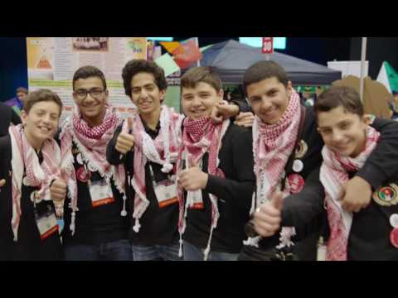
The Competition - Events
Teams usually attend ~2 regional events (unless in a District)
Top teams at regionals qualify for champs
(Winners, Wildcard, Rookie All-Star, Engineering Inspiration, Chairman’s)
Chairman’s Award:
“The most prestigious award at FIRST, it honors the team that best represents a model for other teams to emulate and best embodies the purpose and goals of FIRST.”
Other awards: Engineering Inspiration, Entrepreneurship, Innovation In Control, Creativity, Spirit, Imagery, Safety

Slide 9
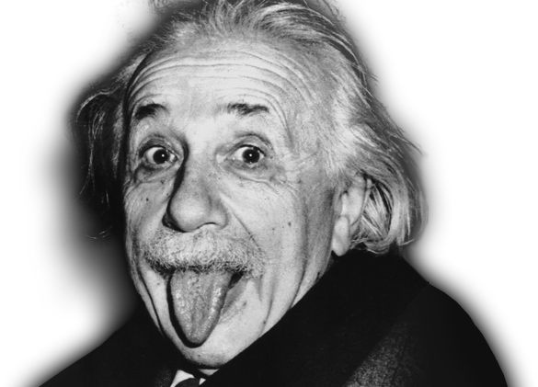
The Competition - Championships
2017: 2 Champs (Houston, St. Louis)
6 Divisions
Carver, Galileo, Hopper, Newton, Roebling, Turing
Teams randomly assigned a division
Each played like a separate regional/event, with quals/alliance selections
Einstein
Round-robin between winners of each division
Champs Chairmans winners are inducted into the FIRST Hall Of Fame

Slide 10
Competitions, Cont.
Scouting
Taking notes on other teams’ performance, for strategy/alliance selection
Pit Speaking
Talking about our team and robot to judges

Slide 11
Movie Time!
2016 Matches
Einstein SF1M2
Chezy Champs Finals 1
Release Videos
118, 971

Slide 12
USEFUL RESOURCES
Chief Delphi: FRC Forum (www.chiefdelphi.com)
Teams’ designs, strategy talks, polls, information - literally everything
FRC Website http://www.firstinspires.org/robotics/frc
FRC Blog: www.firstinspires.org/robotics/frc/blog/
Game Manual/Official Q&A
Official Resources
The Blue Alliance (www.thebluealliance.com)
Match scores, livestreams/video, team stats/history

Slide 13
TEAM RESOURCES
Mailchimp: Mailing List
Slack: Team-wide Chat
Newsletters & Social Media

